Slide 1
Weather analysis
project

Slide 2
INTRODUCTION
In this weather analysis is the process of examining historical weather data to identify patterns, trends, and relationships between different weather attributes. This analysis is crucial for understanding and predicting weather phenomena , which has significant implications for various sectors such as agriculture, transportation, and tourism . Weather data typically includes information such as temperature, Humidity analysis , pressure analysis , wind speed, wind direction, and weather descriptions . By analyzing this data, meteorologists, climatologists, and researchers can gain valuable insights into the behavior of the atmosphere and how it affects our daily lives and also environmental decision making.

Slide 3
Objective
The objective of weather analysis is to gain insights into weather patterns, trends, and relationships between different weather attributes and also Understanding Weather Patterns . Identifying Trends Correlating Weather Attributes Forecasting Improving Weather Prediction Models Supporting Climate Research and decision-making and preparedness for weather-related events.
The scope of weather analysis encompasses a wide range of activities and applications related to studying historical weather data. Data Collection and Management Data Cleaning and Preprocessing Exploratory Data Analysis (EDA) Statistical Analysis AND Predictive Modeling It plays a crucial role in understanding the complex dynamics of the atmosphere and its implications for society and the environment.
Analysis scope

Slide 4
Goal
The goal of weather analysis is to extract meaningful insights and knowledge from weather data to better understand and predict atmospheric conditions. weather analysis aims to provide valuable insights and information that can be used to improve our understanding of the weather and its impacts on society and the environment.
Insights & recommendatons
Weather analysis can provide several valuable insights and recommendations based on the analysis of historical weather data. weather analysis can provide valuable insights and recommendations across various sectors, helping to improve decision-making, optimize resource allocation, and enhance public safety and well-being.
Creating visualizations and reports findings and insights to stakeholders and decision-makers. you can create a comprehensive weather analysis report and presentation that effectively communicates your findings and insights to stakeholders and decision-makersto communicate.
Report & presentation

Slide 5
EDA
&
Questions and Solution

Slide 6
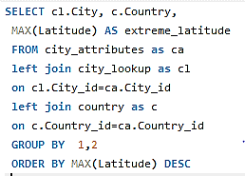
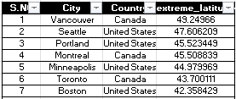
1.Are there any countries with cities located at extreme latitudes, and how might this impact their climate?
In my detail analysis the countries with located at extreme latitudes in max Canada(Vancouer(49.24..) and min extreme latitude in United States(Miami(25.77..).Focus on temperature regions .Impact their climate Extreme latitudes, near the poles, often experience colder climates due to the angle at which sunlight reaches the Earth's surface, leading to longer winters and shorter summers.

Slide 7
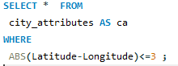
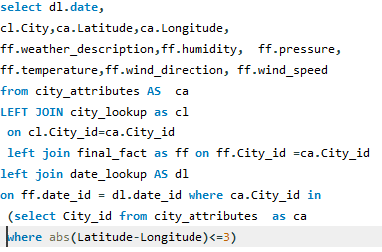
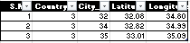
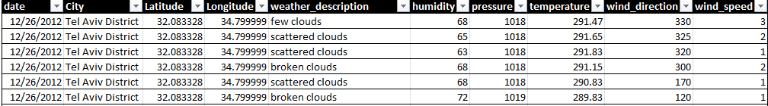
2.Can you identify any clusters of cities with similar latitude and longitude values? What factors might explain these clusters
me identify the cities with similar latitude and longitude values.Query write clusters of cities for similar latitude and longitude values.
This query provides their geographical distribution.

Slide 8
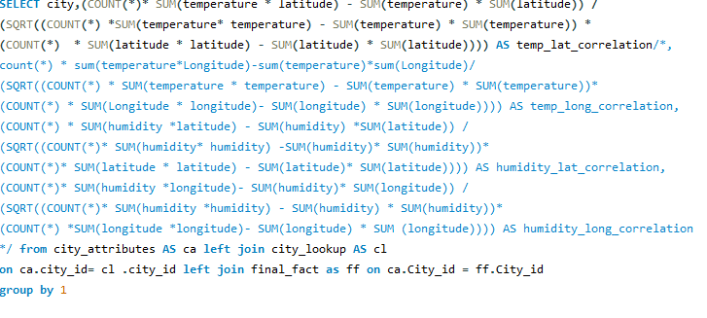
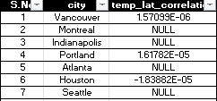
3.Are there any correlations between a city's geographical location (latitude and longitude) and its weather attributes, such as temperature or humidity?
In correlations between a city's geographical location and its weather attributes in my analysis cities at higher latitudes are generally cool and coastal cities are to have high humidity.

Slide 9
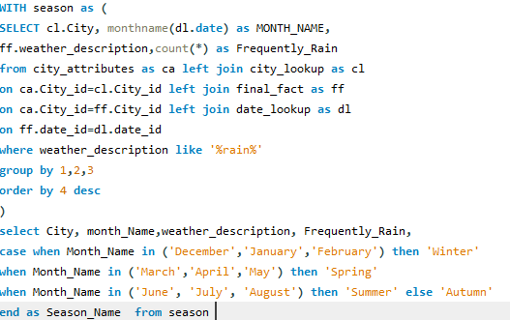
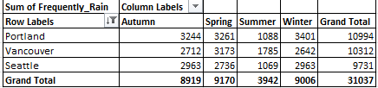
4.Identify the top three cities with the most frequent occurrence of rainy weather based on weather descriptions. What are the seasonal patterns?
In my detail analysis i got top three cities name was portland ,seattle and vacouver these are top cities the most frequent occurrence of rainy weather in the seasonal patterns.portland is heavly rainly seasons .

Slide 10
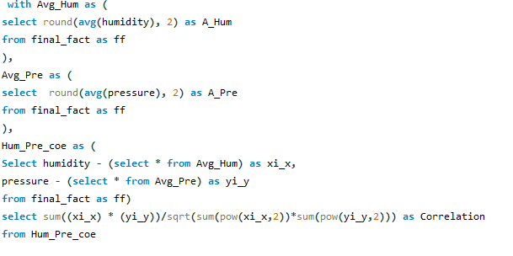
5.Is there a correlation between humidity levels and air pressure? How might this relationship affect weather conditions?
In my analysis there is often a correlation between humidity levels and air pressure. Generally, higher humidity levels are associated with lower air pressure, and vice versa. This relationship is influenced by various factors such as temperature, altitude, and weather patterns. Understanding this correlation can help predict weather changes, as changes in humidity and air pressure can indicate the approach of a weather system, such as a storm or a period of dry weather.

Slide 11
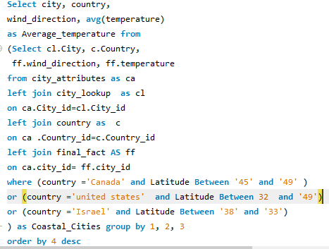
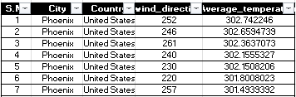
6.Explore the impact of wind direction on temperature for coastal cities. Are there noticeable patterns?
In my analysis the impact of wind direction ontemperature for coastal cities are focusing the canada ,united states and israel.in analysis in the patterns .such as higher temperatures associated with specific wind directions, which could indicate the influence of sea breezes or other local meteorological phenomena.

Slide 12
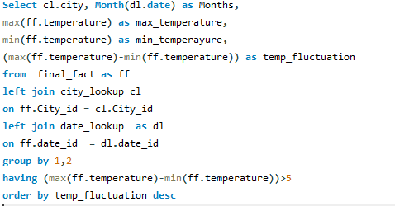
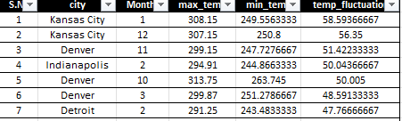
7.Are there specific months when cities experience significant temperature fluctuations? What might explain these variations?
In my analysis when cities experience significant temperature fluctuations in months are feb,aug and dec in temperature fluctuation.When the weather is shifting from hot to cold or vice versa. This is due to the changing angle of the sun, varying daylight hours, and the movement of air masses.

Slide 13
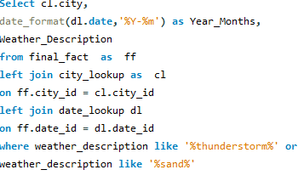
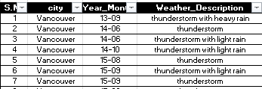
8.Identify periods of extreme weather events, such as storms or heatwaves, by analyzing the time-based data. What patterns emerge?
In my analysis These events typically occur during certain seasons or months, influenced by factors like atmospheric conditions and geographical location. By analyzing the time-based data noteigeable patterns and regions diffrences it my used to prepardness and sategies for various weather challeges.

Slide 14
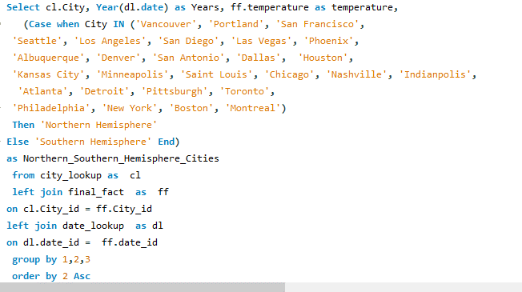
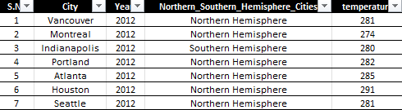
9.Are there any notable differences in temperature trends between northern and southern hemisphere cities over the year? How do they relate to seasons
In my analysis notable differences in temperature trends between northern and southern hemisphere cities over the year in an opposite seasons In the insligths of the hermispheric variations.This is due to the tilt of the Earth's axis. which causes the northern hemisphere to experience more pronounced seasons.

Slide 15
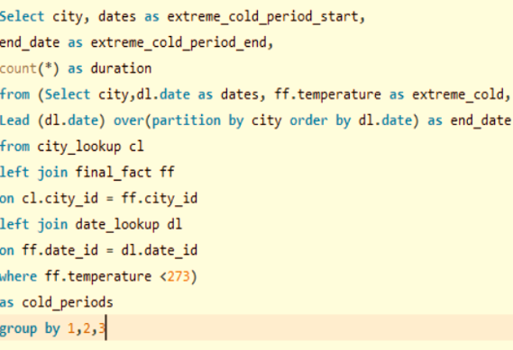
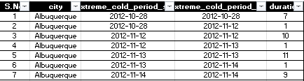
10.What are the consequences of prolonged periods of extreme cold or heat in specific cities? How do residents adapt to such conditions?
In general, northern hemisphere cities tend to experience greater temperature variations throughout the year compared to southern hemisphere cities. my analysis consequences of prolonged periods of extreme cold or heat in specific cities in health conditions,energyissues,infrastructured.futher is important for urban planning.

Slide 16
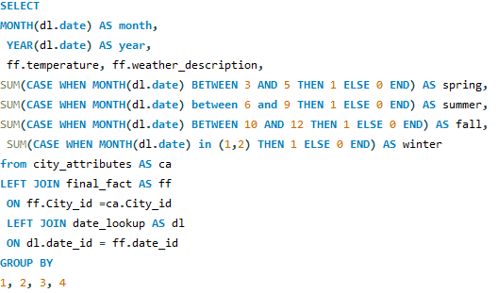
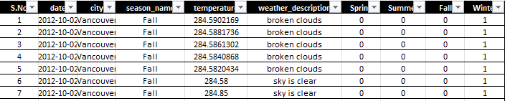
11.Investigate whether temperature anomalies (unusual deviations from the norm) coincide with certain events or environmental factors in specific cities.
In my analysis whether temperature anomalies coincide with certain events or environmental factors in specific cities in temperature and weather decription. The causes of whether temperature anomalies and also disaster prediction in specific cities.

Slide 17
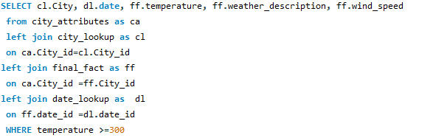
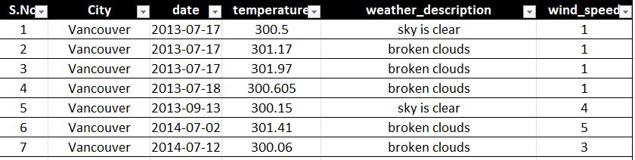
12.Analyze the impact of temperature on energy consumption patterns in cities. Are there noticeable trends or correlations?
In my analyze the impact of temperature on energy consumption patterns in cities,above kelvin(300) is high energy . potentially establish a relationship between temperature variations and energy demand fluctuations.

Slide 18
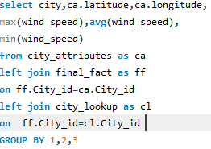
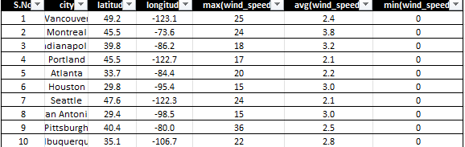
13.How do specific wind patterns impact air quality and pollution dispersion in urban areas? Analyze wind direction data for insights.
In analysis wind direction data in the specific wind patterns impact air quality and pollution dispersion in urban areas higher wind speeds can effectively disperse pollutants.The direction of the wind the flow pattern and distribution of pollutants with in area.

Slide 19
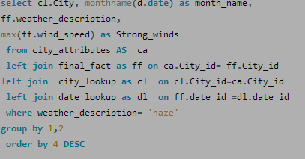
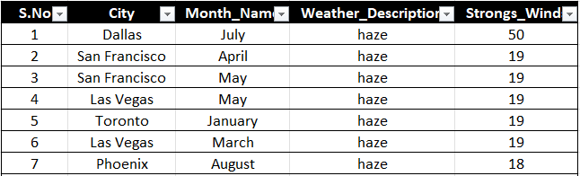
14.Identify cities prone to strong winds and the potential consequences, such as increased risk of natural disasters or challenges for transportation.?
In my analysis to strong winds and the potential consequences, such as increased risk of natural disasters or challenges for transportation challenges under standing disaster readness and futher urban planning. Consequences may include increased risk of natural disasters like storms or challenges for transportation and infrastructure due to wind-related hazards.

Slide 20
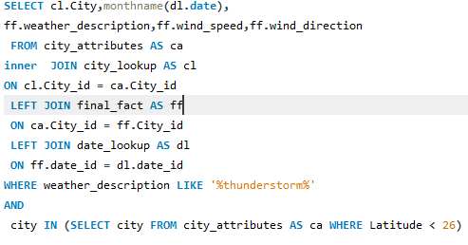
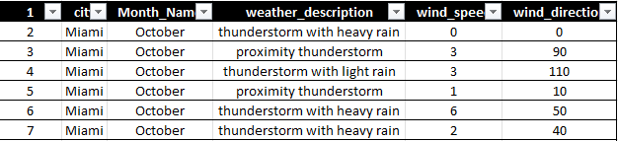
15.Explore whether wind speed and direction influence the frequency and severity of weather-related events (e.g., hurricanes, storms) in coastal cities.
In my explore data analysis detail about the relation between wind speed and direction weather-related events in coastal cities. in improve distaster management and readness for the hurricanes, storms.

Slide 21
Power Bi & Dishboards

Slide 22
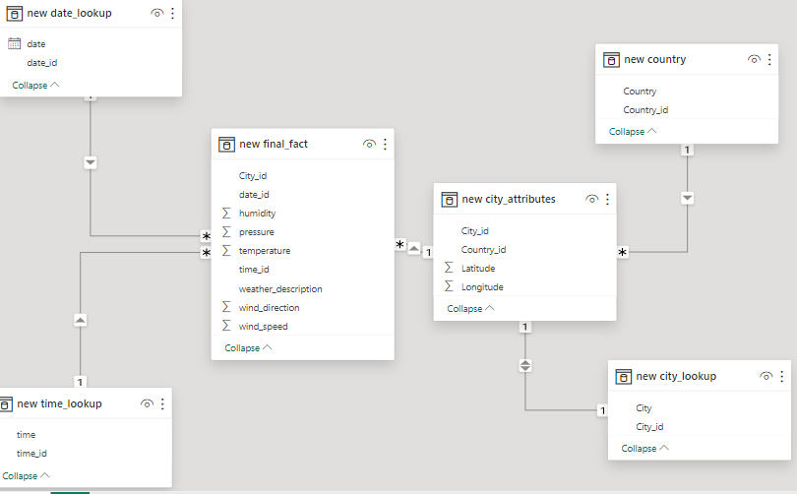
Data Modeling

Slide 23
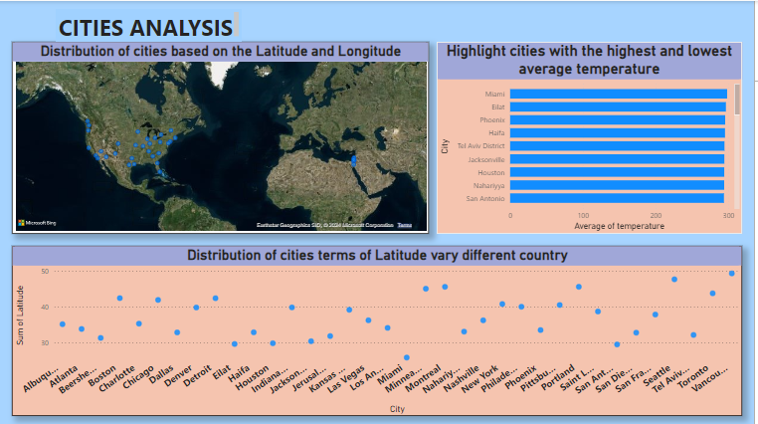

Slide 24
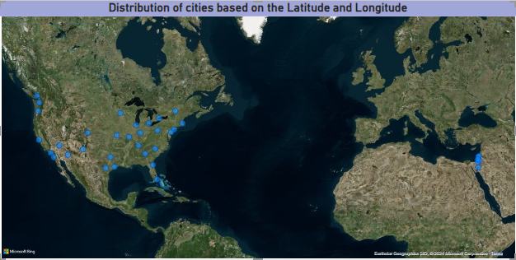
The geographical maps in power bi shows the distribution of cities based on the latitude and longitude . Its showing the global diversity.Mainly useful for the decision making climate conditions. Cosatal cities nearest seas.

Slide 25
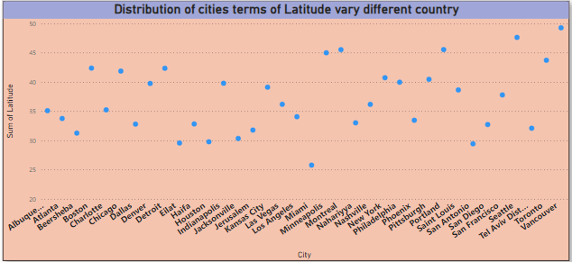
In this scatter plot in power bi showing distribution of cities in terms of latitude vary different countrys .low latitudes shows near by the equator and higher latitudes shows the Europe and America.In this chart varying different cities in countrys.

Slide 26
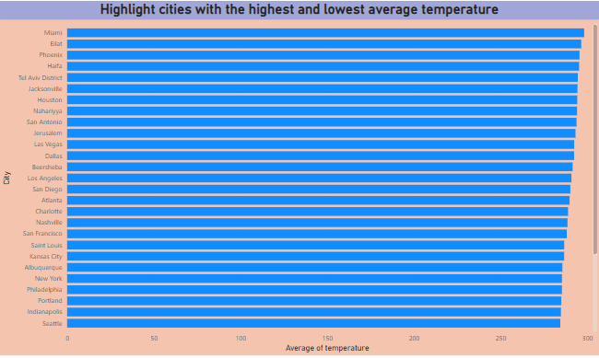
In bower bi bar chart shows the cities with the highest and lowest average temperature .Highlighted temperature varations with one has highest average temperature and another has lowest temperature. In visualizations are this mainly futher ducesion making urban planning.

Slide 27
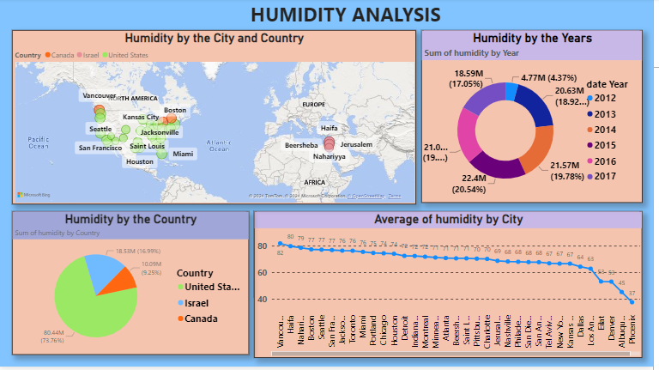

Slide 28
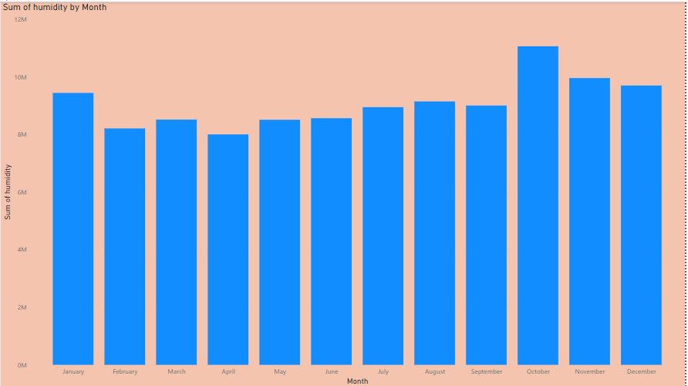
In the power bi coloum charts shows difference humidity by the month .In highest humidity in October month and low humidity in April month.

Slide 29
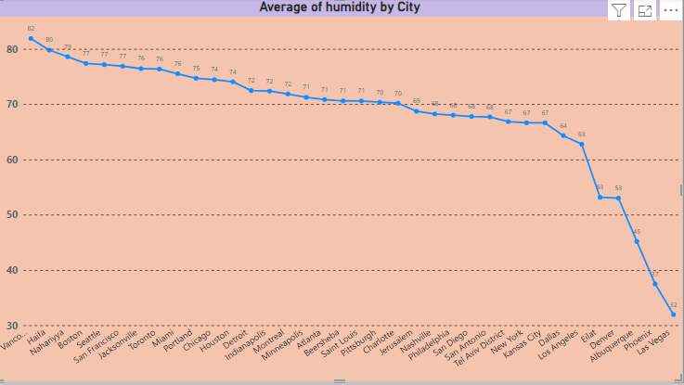
In power bi line chart trends of the humidity by the cities .In highest trend value is 82 and lowest trend value 32 in cities.

Slide 30
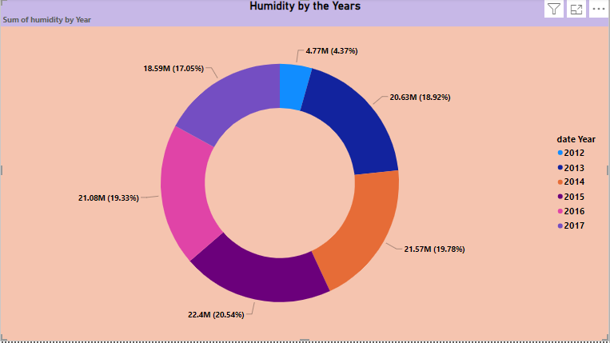
In docunt chart shows the humidity by the year. Separated by the humidity by years to showcase the humidity also as percentage, here you can see 2014 has high humidity and 2012 has low humidity in dount chart shows.

Slide 31
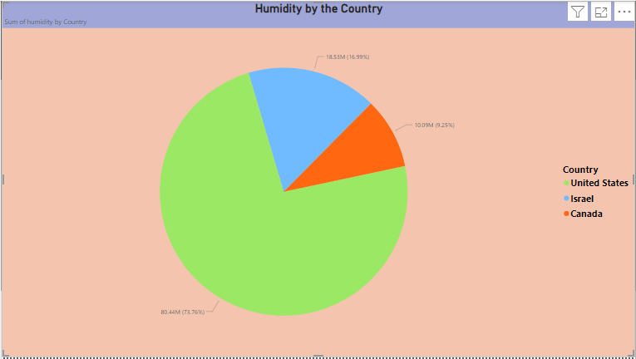
The power bi pie chart shows the humidity by countrys, have you can united states high humidity and low as Canada.which can lead ev.aporation, causing the air to feel drier and cooler. .

Slide 32
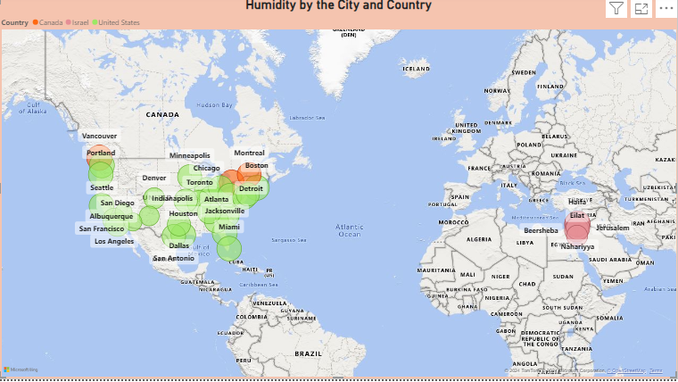
In the power bi heat map shows humidity by the cities and countrys.Most of the cities high humidity and few cities low humidity.

Slide 33
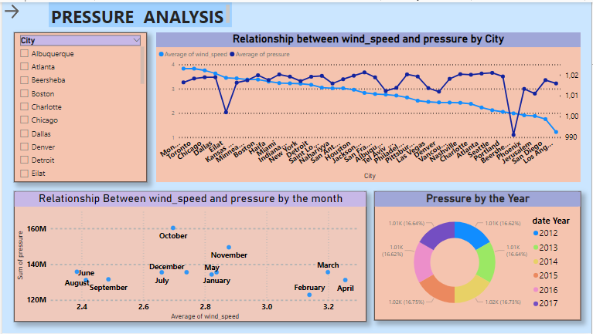

Slide 34
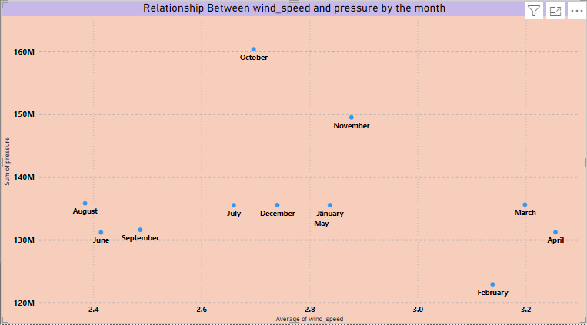
The power bi scatter plot shows relationship between wind speed and pressure by the month . Higher wind speed was linked to lower air pressure . Valuable for meteorology and storm monitoring.

Slide 35
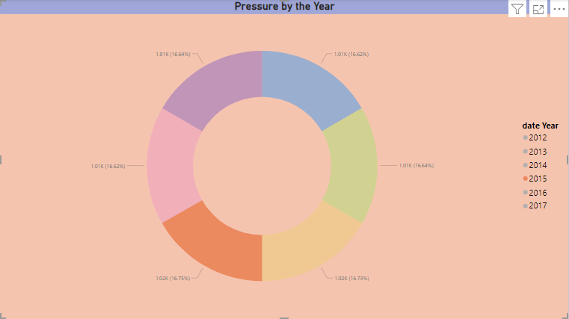
The power bi donut chart shows pressure by the year . In donut chart divided into difference pertcenges in pressure.

Slide 36
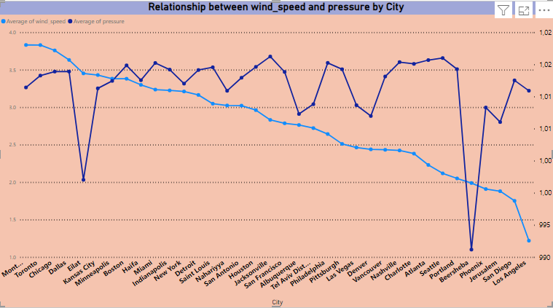
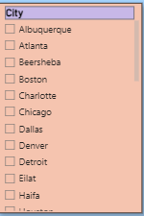
The power bi time series shows relation ship between wind speed and pressure by cities and also you identify the relation ship between any of the cities after selecting cities in slicer.

Slide 37
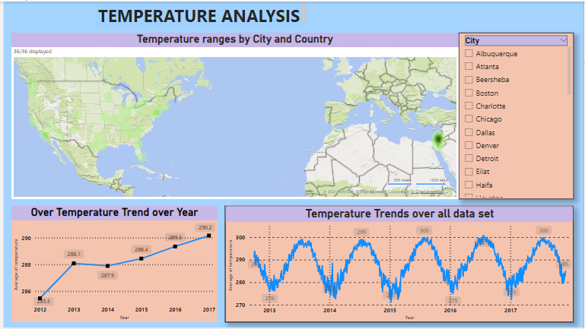

Slide 38
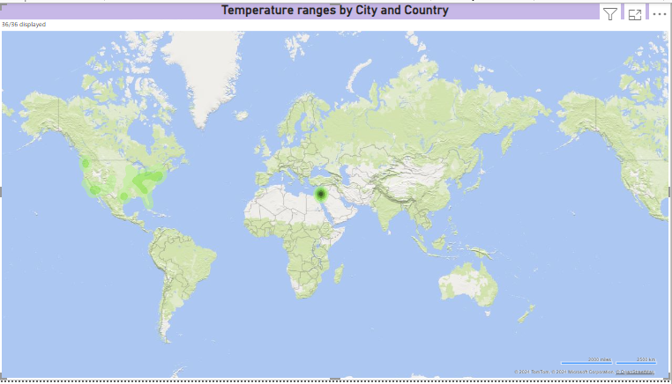
The bower bi heat map to show the temperature ranges for cities across different countries .Equatorial regions stayed consistently warn, while distant areas experienced more seasonal variations . coastal cities displayed milder temperature ranges due to the sea s influence.

Slide 39
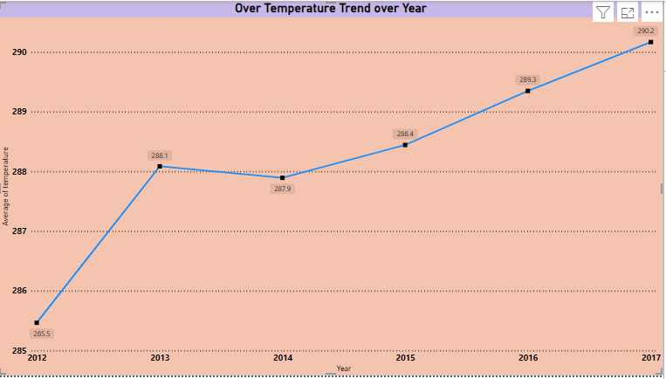
The power bi line chart shows the over temperature trend over year . Extreme temperatures can cause severe weather events like heat waves , droughts, floods and storms.

Slide 40

The power bi time series shows over all temperature trend over month .it revealed a gradual warming trend with distinct seasonals. The used to futher urban planning.

Slide 41

The power bi time series shows over all temperature trends over the data.

Slide 42


Slide 43

In power bi heat map shows the here you can see the busiest hours of specific weather conditions to analyze the weather conditions like rainy hours, thunderstorm hours, clear sky.

Slide 44

The Power BI radial chart showcased daily wind speed fluctuations, with lower speeds in the early morning and peaks in the late afternoon, linked to daytime heating. Vital for energy, agriculture, and urban planning.

Slide 45

The Power BI Bar Chart shows the top 3 Countries with the highest number of cities due to shortage of data by countries, here you can see United states has the highest number of cities

Slide 46
Power Bi and Questions & Charts

Slide 47

1.Can you create a geographical map in Power BI showing the distribution of cities in the dataset based on their latitude and longitude?

Slide 48

2.In Power BI, can you create a bar chart representing the top 10 countries with the highest number of cities in the dataset?

Slide 49

3.How does the distribution of cities in terms of latitude vary across different continents? Create a scatter plot in Power BI to illustrate this.?

Slide 50

4.Create a line chart in Power BI to display the temperature trends over time for a selected city. Highlight extreme temperature events.

Slide 51

5.How does humidity vary across different cities? Generate a heatmap in Power BI to visualize this variation.

Slide 52

6.How does humidity vary across different cities? Generate a heatmap in Power BI to visualize this variation.

Slide 53

7.Create a time-series line chart in Power BI to show the overall temperature trends over the entire dataset.

Slide 54

8.Can you create a heatmap in Power BI to visualize the busiest hours for specific weather conditions (e.g., "clear sky," "rainy")?

Slide 55
9.How does the wind speed change over the course of a day? Create a radial chart in Power BI to represent this.

Slide 56

10.Create a Power BI chart comparing the temperature variations between two selected cities over a specific timeframe.

Slide 57

11.Can you build a heatmap in Power BI to show the temperature ranges for cities across different countries?

Slide 58

12.Create a bar chart in Power BI to highlight cities with the highest and lowest average temperatures in the dataset.

Slide 59

13.Create a wind rose chart in Power BI to visualize the prevailing wind directions for a selected city.

Slide 60

14.Can you generate a Power BI heatmap illustrating the average wind speeds across cities for different months of the year?

Slide 61

15.Create a Power BI scatter plot to show the relationship between wind speed and air pressure for a specific city.

Slide 62
Conclusion
Based on the Weather Analysis Project, we reflect upon the journey we've undertaken through the realms of meteorological exploration. This endeavor has been a testament to the power of technology and data-driven insights in unraveling the mysteries of weather patterns.
weather analysis, it is evident that temperatures vary significantly between cities, with some experiencing more extreme fluctuations than others. There is a clear seasonal trend, with temperatures generally peaking in summer and dropping in winter. Humidity levels tend to be higher in coastal cities compared to inland cities. Wind speed shows variation based on geographical location, with coastal areas experiencing higher speeds. Overall, the data suggests a complex interplay of geographical and seasonal factors influencing weather patterns.
Weather Analysis Project, let us carry forward the lessons learned and the insights gained, knowing that the tools of data analytics stand ready to illuminate the path ahead, guiding us through the ever-changing landscapes of our dynamic world.

